Slide 2
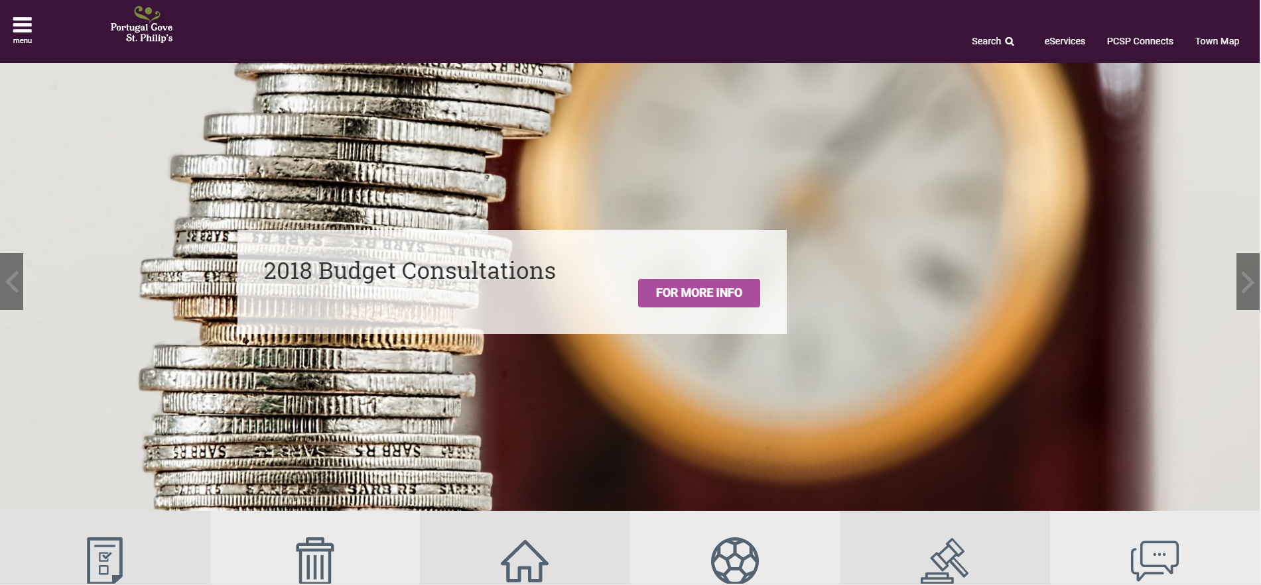
Public Consultations
Public Meetings
Resident Submissions
Community Groups
Social Media

Slide 3
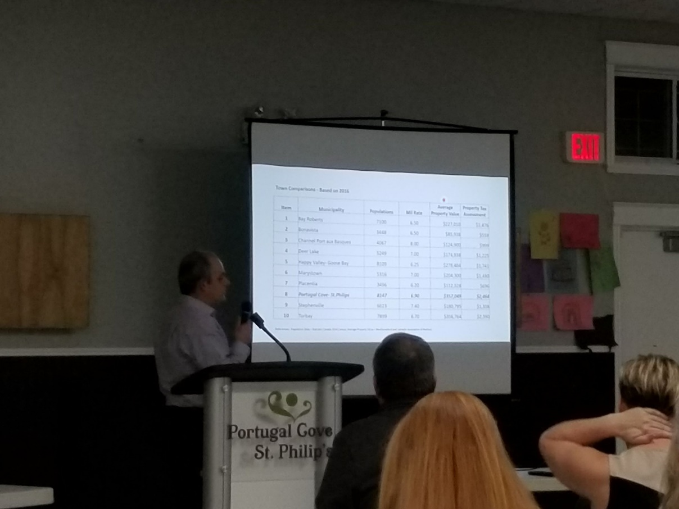
WHAT WE HEARD
Public Input Considerations
REDUCE tax burden on residents
SMART budgeting and community planning
ELIMINATE mandatory residential water metering
SUPPORT local business and tourism
ENGAGE with residents and advisory groups
INCREASE the investment in pedestrian safety

Slide 4
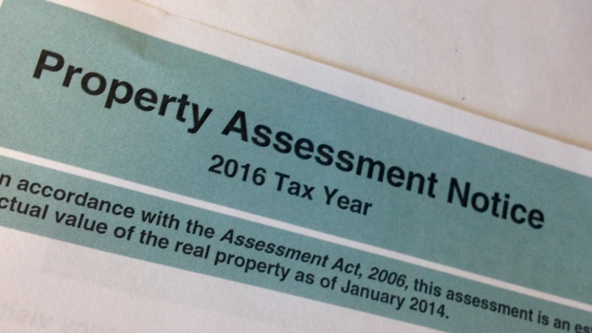
REDUCE tax burden on residents
Reductions in:
Property tax mil rate to 6.5 mils
Residential Water and Sewer Fees

Slide 5
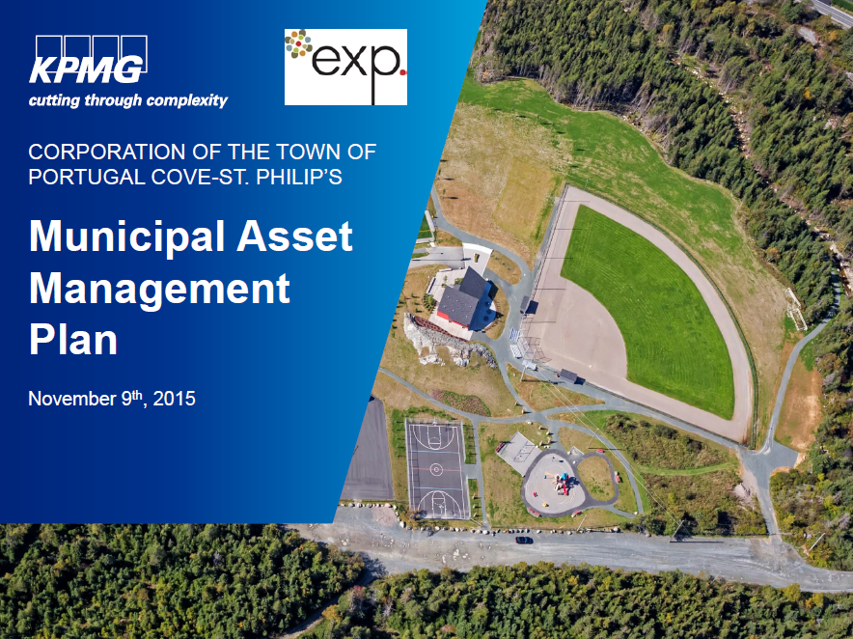
SMART budgeting and community planning
Strategic Plan
Asset Management Plan
Reserve Funds
Long-term financial strategy

Slide 6

ELIMINATE mandatory residential water metering
Mandatory Residential Metering Canceled
Investments in Zone Meters
Water Loss Program and Leak Detection
Potential Volunteer Water Metering Pilot Project

Slide 7
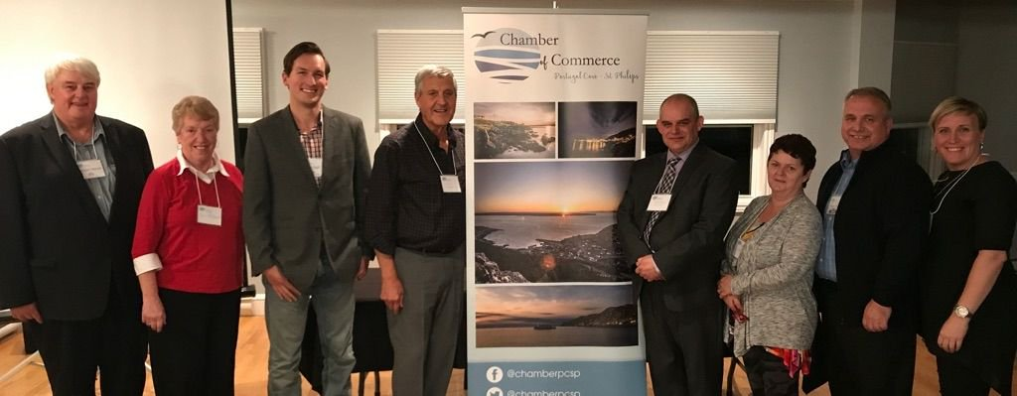
SUPPORT local business and tourism
Reduction in General Business mil rate to 8.1
Reduction in Water and Sewer Fees
Strategic Joint Projects
Financial Support to Chamber of
Commerce

Slide 8
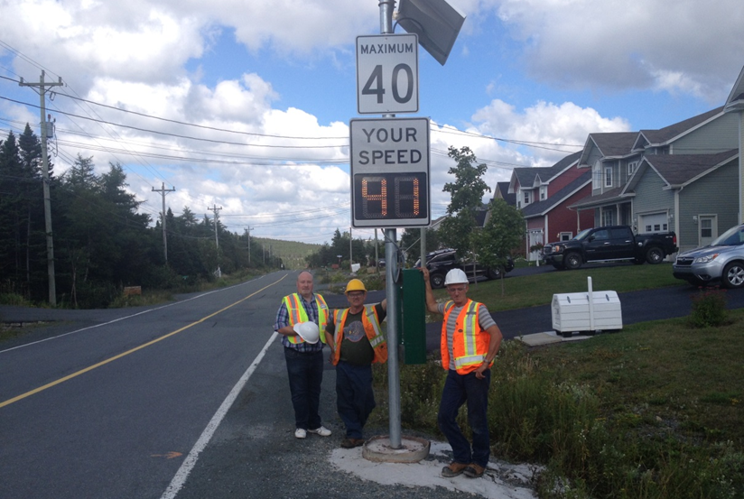
INCREASED investment in pedestrian safety
Better Pedestrian Safety Planning
Funding for SafePCSP
Traffic Calming

Slide 9
ENGAGE with residents and advisory groups
Commitment to work with all stakeholders in the community on projects, initiatives and budgeting

Slide 10
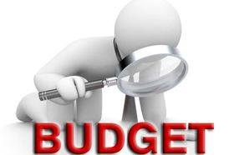

Slide 11
Revenue
Property Tax Revenue | $8,118,479
Business Tax Revenue | $448,871
Water and Sewer Revenue | $932,540
Municipal Operating Grant | $242,596
Government Transfers | $2,537,929
Recreation | $616,358
Development | $82,220
Other Admin | $175,000
Provincial Share of Debt | $389,647
Revenue Carryforward | $519,800
Total Budget Revenue | $14,063,440

Slide 12
Expenditures
Administration | $2,631,668
Fire and Emergency Services | $667,500
Transportation | $2,108,506
Waste Management and Water | $1,347,473
Recreation & Cultural Services | $1,087,533
Capital Financing | $2,563,879
Non Financed Capital Purch. | $2,912,881
Other Fiscal Services | $424,000
Reserve Fund | $320,000
Total Expenditures | $14,063,440

Slide 13
Administration
Council | $167,881
General Administration | $1,232,469
Property Assessment Services | $125,990
Economic Development & Tourism | $350,993
Public Relations & Communications | $92,000
Planning and Development | $470,000
Strategic Projects | $192,335
Total Administration | $2,631,668

Slide 14
Protective Services
Fire Services | $504,500
Enforcement | $126,000
Safety Initiatives – including SafePCSP | $37,000
Total Protective Services | $667,500

Slide 15
Transportation
Fleet Maintenance & Fuel | $469,000
Road Maintenance | $784,000
Snow Removal | $665,506
Street Lighting | $190,000
Total Transportation Expenses | $2,108,506

Slide 16
Waste Management and Water
Water Supply | $588,573
Sewage Collection and Disposal | $351,900
Garbage Collection and Recycling | $407,000
Total Waste Management and Water | $1,347,473

Slide 17
Recreation & Cultural Services
Administration | $441,442
Programs, Activities, Events | $187,140
Library | $47,150
Facilities and Maintenance | $312,800
Parks, Playgrounds and Fields | $99,000
Total Recreation & Cultural Services | $1,087,533

Slide 18
Capital Financing
Debt Charges – Town’s Share | $2,174,232
Debt Charges – Province’s Share | $389,647
Total Fiscal Services | $2,563,879

Slide 19
Non Financed Capital Purchases
Capital out of Revenue | $444,500
Capital from Transfers and Gas Tax | $2,468,381
Total Non Financed Capital | $2,912,881

Slide 20
Other Fiscal Services
Discounts | $350,000
Other Charges and Collection | $74,000
Total Fiscal Services | $424,000

Slide 21
* $1,212,635 will then be total value of the reserve fund which started in 2015
Reserve Fund
Infrastructure Reserve Fund | $320,000
Total Reserve Fund | $320,000

Slide 22
2018 Capital Overview

Slide 23
Protective Services Capital Purchases
Public Works Capital Purchases
½ Tonne Pickup (replacement) $33,000
One Tonne Pickup (replacement) $40,000
Rock Screen $26,000
Zone Meters $300,000
Leak Detection $40,000
Other Water Conservation $408,076
Rescue Replacement $225,000
Emergency Exhausts for Fire Dept. $80,000

Slide 24
Public Works Capital Purchases
5500 Truck (new) $110,000
Snow blower Attachment $130,000
Curb and Gutter $100,000
Storage Sheds $25,000
Sewer Assessment $15,000
Key Card System $24,000
Excavator Track Replacement $20,000
Compact SUV (replacement) $33,000
Diagnostic Scanner $10,000
Waste Water Plant Fencing $11,000

Slide 25
Recreation Capital Purchases
Planning
Inclusion Equipment for Parks $126,500 Field Netting – Voiseys Brook $8,000
Lifestyle Centre Planning $86,200
Beautification $115,000 Trail Upgrades – Rainbow Gully $57,000
Poles and Netting – Rainbow Gully $34,500
Hydrology Update and Aerial $37,500

Slide 26
Public Works Capital Projects
Other Capital
Westpoint Road – Asphalt $36,380 Newbury Street Completion $183,847
Tolt Road Upgrades $906,653 Drover Heights W&S $480,544 Old Cart and Mitchell Access $200,000 Broad Cove Ridge Completion $91,747
Town Signs $200,000
Beachy Cove Lookout $100,000
Museum $30,000

Slide 27


